Slide 1
Introduction to Artificial Neural Network

Slide 2
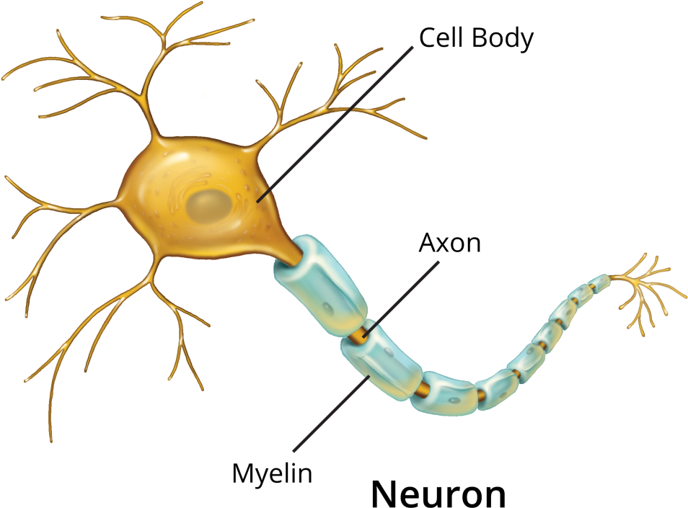
ANN
Biological Neuron
Axon: transmits output
Dendrite: receives signals from other neurons
Soma: process the information
Synapse: point of connection to other neurons

Slide 3




ANN
Biological Neuron
Let us see how it works
Our sense organs interact with the world out side
They relay the information to the neurons
The neurons (may) get activated and produces a response -> whether to eat the pizza or not
In reality it is just not a single neuron, but a massively parallel network of neurons

Slide 4
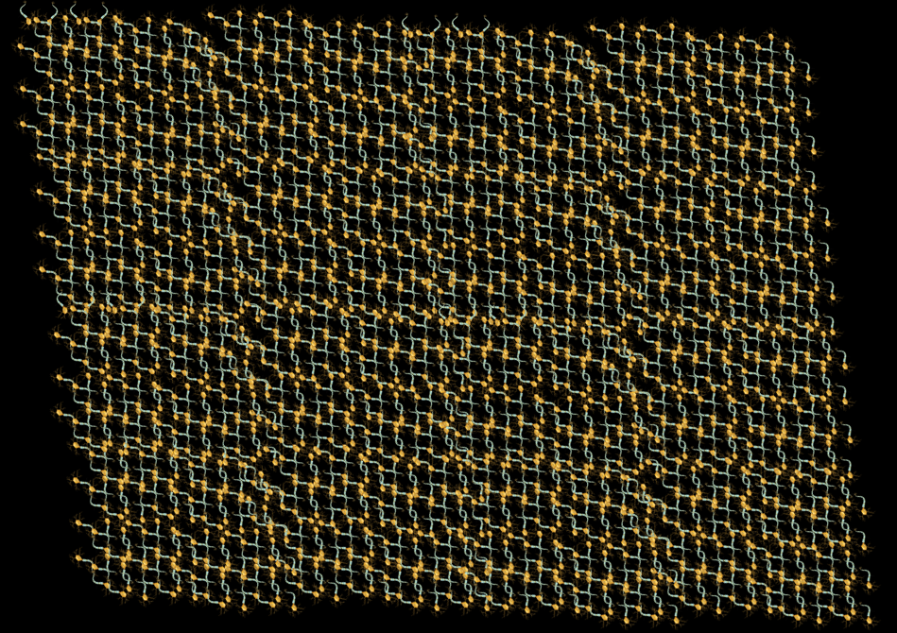
ANN
Biological Neuron
There is a massively parallel interconnected network of neurons
The sense organs relay the information to the lowest layer of neurons
Some of these neuron may fire in response to this information and in turn relay information to other neurons they are connected to
These neurons may also fire and the process continues eventually resulting in a response.
Massively parallel interconnected network of neurons: an average human brain has around 10¹¹ (100 billions) neurons!
Each neuron may perform a certain role or respond to a certain stimulus

Slide 5
ANN
Biological Neuron
There is a massively parallel interconnected network of neurons
The sense organs relay the information to the lowest layer of neurons
Some of these neuron may fire in response to this information and in turn relay information to other neurons they are connected to
These neurons may also fire and the process continues eventually resulting in a response.
Massively parallel interconnected network of neurons: an average human brain has around 10¹¹ (100 billions) neurons!
Each neuron may perform a certain role or respond to a certain stimulus
Taste
Visuals
Smell

Slide 6

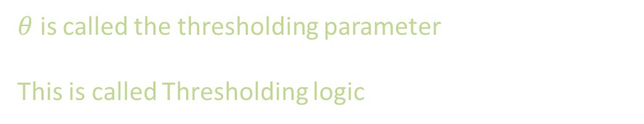
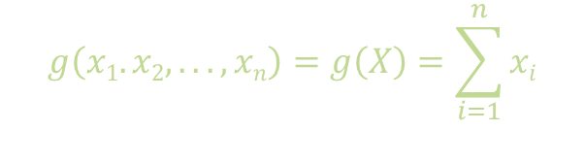
ANN
Biological Neuron
McCulloch Pitts Neuron
McCulloch and Pitts proposed a highly simplified computational model of the neuron
g aggregates the inputs, and the function f takes a decision based on this aggregation.
The input can be excitatory or inhibitory
y=0 if any x_{i} is inhibitory, else
$$y∈\{0,1\}$$
f
g
$$g\left(x1.x2, . . ., xn\right)=g\left(X\right)=\sum_{i=1}^{n}{xi}$$
x₁ x₂ x₃ …. x_{n} {0,1}
$$∈$$
$$y=f\left(g\left(X\right)\right)=1 if g\left(X\right)≥θ$$
$=0 if g\left(X\right)<θ$
$θ$ is called the thresholding parameter
This is called Thresholding logic

Slide 7


ANN
Biological Neuron
McCulloch Pitts Neuron
Boolean Functions and Decision Boundaries
$$y∈\{0,1\}$$
$$y∈\{0,1\}$$
$$y∈\{0,1\}$$
$$θ$$
3
1
x₁ x₂ x₃
x₁ x₂ x₃
x₁ x₂ x₃
AND Function
OR Function

Slide 8
ANN
Biological Neuron
McCulloch Pitts Neuron
Boolean Functions and Decision Boundaries
$$y∈\{0,1\}$$
$$y∈\{0,1\}$$
$$y∈\{0,1\}$$
$$θ$$
0
1
x₁
x₁ x₂ x₃
x₁ x₂
NOT Function
x₁ AND !x₂

Slide 9

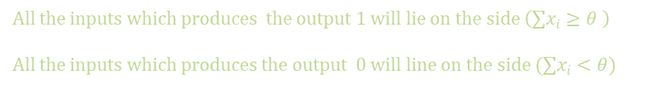









ANN
Biological Neuron
McCulloch Pitts Neuron
Boolean Functions and Decision Boundaries
$$y∈\{0,1\}$$
$$x1$$
$$(0,1)$$
$$(1,1)$$
$$x1+x2=θ= 1$$
$$1$$
$$(0,0)$$
$$(1,0)$$
$$x2$$
x₁ x₂
All the inputs which produces the output 1 will lie on the side $\left(∑xi≥θ \right)$
All the inputs which produces the output 0 will line on the side $(∑xi<θ)$
OR Function
$$x1+x2=∑xi≥1$$
$x1+x2=1$ (Equation of line)

Slide 10




ANN
Biological Neuron
McCulloch Pitts Neuron
Boolean Functions and Decision Boundaries
$$y∈\{0,1\}$$
$$x1$$
$$(0,1)$$
$$(1,1)$$
$$2$$
$$x1+x2=θ=2$$
$$(0,0)$$
$$(1,0)$$
$$x2$$
x₁ x₂
All the inputs which produces the output 1 will lie on the side $\left(∑xi≥θ \right)$
All the inputs which produces the output 0 will line on the side $(∑xi<θ)$
AND Function
$$x1+x2=∑xi≥2$$
$x1+x2=$ 2 (Equation of line)

Slide 11



ANN
Biological Neuron
McCulloch Pitts Neuron
Boolean Functions and Decision Boundaries
$$y∈\{0,1\}$$
$$x1$$
$$(0,1)$$
$$(1,1)$$
0
$x1+x2=θ=$0
$$(0,0)$$
$$(1,0)$$
$$x2$$
x₁ x₂
All the inputs which produces the output 1 will lie on the side $\left(∑xi≥θ \right)$
All the inputs which produces the output 0 will line on the side $(∑xi<θ)$
Tautology (always on)
$x1+x2=∑xi≥$0
$x1+x2=$ 0 (Equation of line)

Slide 12












ANN
Biological Neuron
McCulloch Pitts Neuron
Boolean Functions and Decision Boundaries
$$x1$$
$$y∈\{0,1\}$$
$$(1,1,0)$$
$$(0,1,0)$$
$$(0,1,1)$$
$$(1,1,1)$$
$$1$$
$$(0,0,0)$$
$$(1,0,0)$$
$$x2$$
x₁ x₂ x₃
$$(0,0,1)$$
$$(1,0,1)$$
OR Function
$$x3$$
$$x1+x2+x3=∑xi≥1$$

Slide 13


ANN
Biological Neuron
McCulloch Pitts Neuron
Boolean Functions and Decision Boundaries
$$x1$$
$$y∈\{0,1\}$$
$$(1,1,0)$$
$$(0,1,0)$$
$$x1+x2+x3=θ=1$$
$$(0,1,1)$$
$$(1,1,1)$$
$$1$$
$$(0,0,0)$$
$$(1,0,0)$$
$$x2$$
x₁ x₂ x₃
$$(0,0,1)$$
$$(1,0,1)$$
OR Function
$$x3$$
$$x1+x2+x3=∑xi≥1$$
$$x1+x2+x3=1$$

Slide 14
ANN
Biological Neuron
McCulloch Pitts Neuron
Boolean Functions and Decision Boundaries
A single MuCulloch Pitts Neuron can be used to represent boolean functions which are linearly separable
Linear separability: there exists a line/plane such that all inputs which produce 1 lie on one side of line/plane and all inputs which produce which produce a 0 lie on the other side of the line/plane

Slide 15

ANN
Biological Neuron
McCulloch Pitts Neuron
Boolean Functions and Decision Boundaries
Perceptron
$$y$$
What about non-Boolean inputs?
Do we always need to hand code the threshold?
Are all inputs equals? What if we want to assign more
weight/importance to some inputs?
What about functions which are not linearly separable?
w₁ w₂ … w_{n}
x₁ x₂ … x_{n}

Slide 16
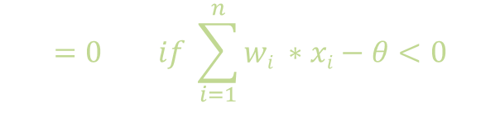
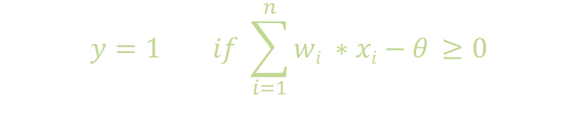

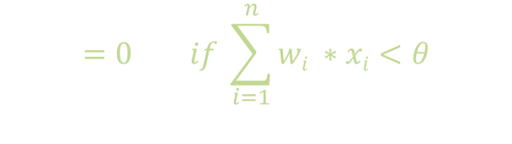

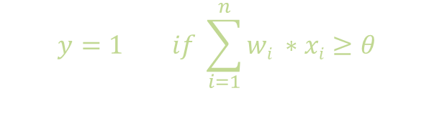


ANN
Biological Neuron
McCulloch Pitts Neuron
Boolean Functions and Decision Boundaries
Perceptron
$$y$$
$$y=1 if \sum_{i=1}^{n}{wi ∗xi≥θ}$$
$$=0 if \sum_{i=1}^{n}{wi ∗xi<θ}$$
Rewriting the above
w₀ = - $θ$
w₁ w₂ … w_{n}
$$y=1 if \sum_{i=1}^{n}{wi ∗xi−θ ≥0}$$
x₀ = 1
x₁ x₂ … x_{n}
Convention
$$=0 if \sum_{i=1}^{n}{wi ∗xi−θ<0}$$
$$y=1 if \sum_{i=0}^{n}{wi ∗xi ≥θ}$$
$$=0 if \sum_{i=0}^{n}{wi ∗xi<θ}$$
where $x0=1 and w0=−θ$
Notes:
In effect what are we assuming that instead of having this threshold separately we just think that this theta is one of its input which is always on and the weight of that input is –theta
So the job of all other inputs and there weight is to make sure that their sum should be greater than this input we have,

Slide 17
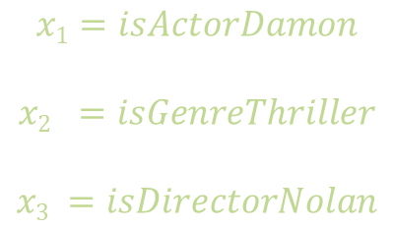

ANN
Biological Neuron
McCulloch Pitts Neuron
Boolean Functions and Decision Boundaries
Perceptron
Why do we need weights?
Consider task of prediction whether one likes a movie or not
Based on our past experience (data), we may give a high weight to $isDirectiorNolan$ as compared to the other inputs
Specifically, even if the actor is not Matt Damon and the genre is not thriller we would still want to cross the threshold $θ$ by assigning a high weight to $isDirectorNolan$
$$y$$
w₀ = - $θ$
w₁ w₂ … w_{n}
x₀ = 1
x₁ x₂ … x_{n}
$$x1=isActorDamon$$
$$x2 =isGenreThriller$$
$$x3 =isDirectorNolan$$

Slide 18
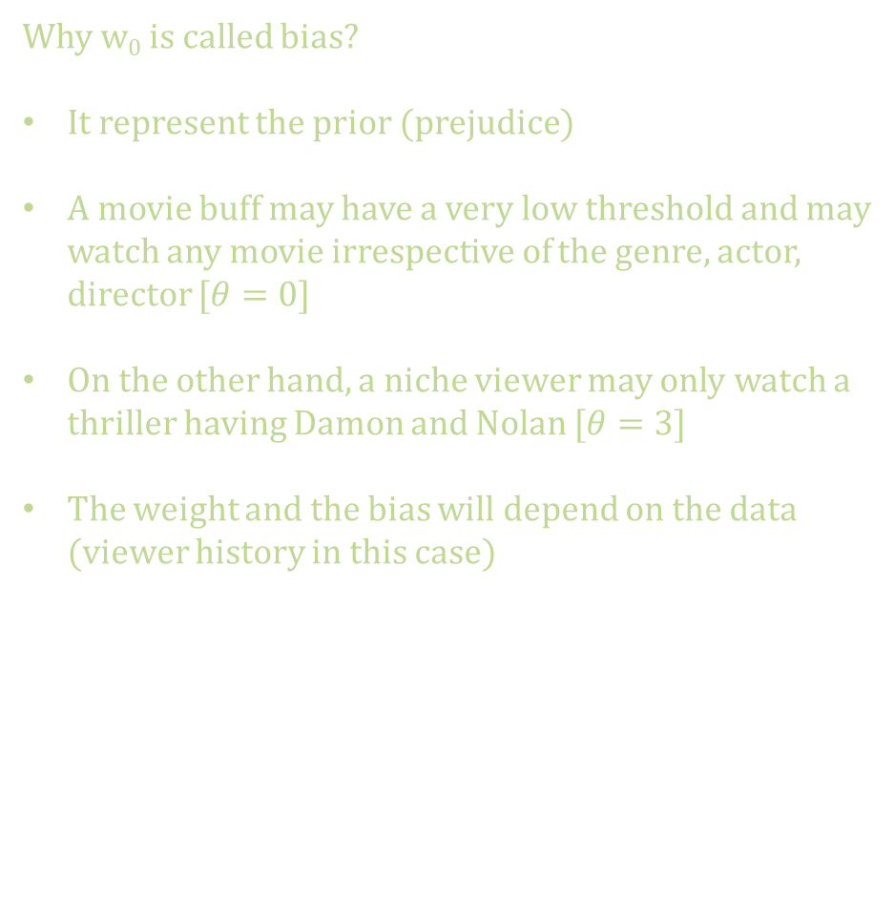
ANN
Biological Neuron
McCulloch Pitts Neuron
Boolean Functions and Decision Boundaries
Perceptron
Why w₀ is called bias?
It represent the prior (prejudice)
A movie buff may have a very low threshold and may watch any movie irrespective of the genre, actor, director $[θ=0]$
On the other hand, a niche viewer may only watch a thriller having Damon and Nolan $[θ=3]$
The weight and the bias will depend on the data (viewer history in this case)
$$y$$
w₀ = - $θ$
w₁ w₂ … w_{n}
x₀ = 1
x₁ x₂ … x_{n}
$$x1=isActorDamon$$
$$x2 =isGenreThriller$$
$$x3 =isDirectorNolan$$

Slide 19


ANN
Biological Neuron
McCulloch Pitts Neuron
Boolean Functions and Decision Boundaries
Perceptron
From the equation it should be clear that even a perceptron separates the input space into two halves
All inputs which produce a 1 lie on one side and all inputs which produce a 0 lie on the other side
In other words, a single perceptron can only be used to implement linearly separable functions
Difference? The weights including the threshold can be learned and the inputs can be real valued
MuCulloch Pitts Neuron
(assuming no inhibitory inputs)
$$y=1 if \sum_{i=0}^{n}{xi ≥θ}$$
$$=0 if \sum_{i=0}^{n}{xi<θ}$$
Perceptron
$$y=1 if \sum_{i=0}^{n}{wi ∗xi ≥θ}$$
$$=0 if \sum_{i=0}^{n}{wi ∗xi<θ}$$

Slide 20

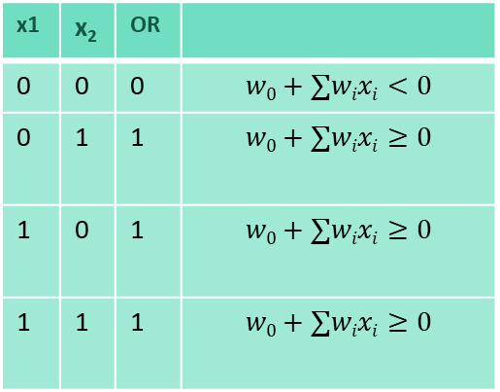
ANN
Biological Neuron
McCulloch Pitts Neuron
Boolean Functions and Decision Boundaries
Perceptron
Linearly Separable functions
x1 | x₂ | OR
0 | 0 | 0 | $$w0+∑wixi<0$$
0 | 1 | 1 | $$w0+∑wixi≥0$$
1 | 0 | 1 | $$w0+∑wixi≥0$$
1 | 1 | 1 | $$w0+∑wixi≥0$$
$$x1$$
$$(0,1)$$
$$(1,1)$$
$$−1+1.1x1+1.1x2=0$$
$$(0,0)$$
$$(1,0)$$
$$x2$$
$$w0+\left(w1 ∗0\right)+\left(w2 ∗0\right)<0 =⇒ w0<0$$
$$w0+\left(w1 ∗0\right)+\left(w2 ∗1\right)≥0 =⇒ w2≻−w0$$
$$w0+\left(w1 ∗1\right)+\left(w2 ∗0\right)≥0 =⇒ w1≻−w0$$
$$w0+\left(w1 ∗1\right)+\left(w2 ∗1\right)≥0 =⇒ w1+w2≻−w0$$
One possible solution to this set of inequalities is w₀ = -1, w₁= 1.1, w₂=1.1 (various other solution are possible)

Slide 21
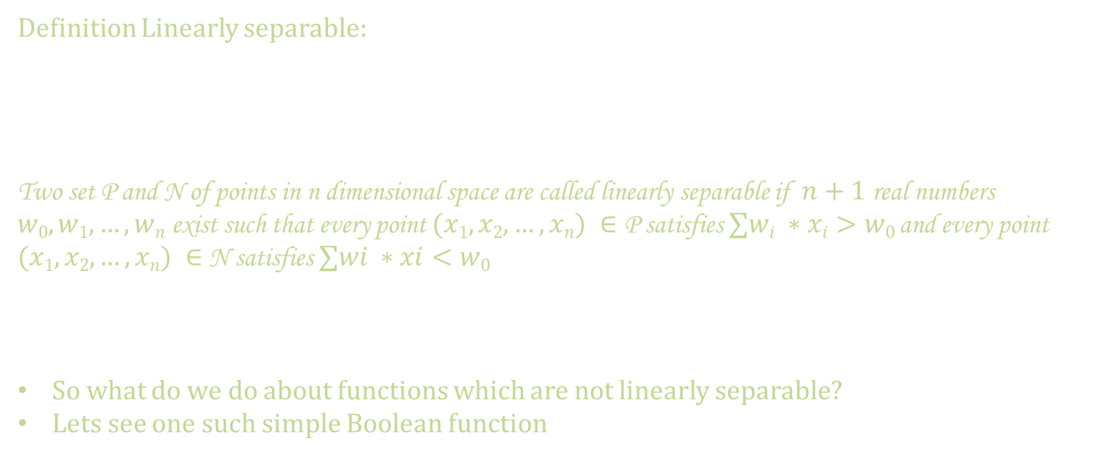
ANN
Biological Neuron
McCulloch Pitts Neuron
Boolean Functions and Decision Boundaries
Perceptron
Linearly Separable functions
Definition Linearly separable:
Two set P and N of points in n dimensional space are called linearly separable if $n+1$real numbers $w0,w1, …,wn$exist such that every point $(x1,x2,…,xn) ∈$ P satisfies $∑wi ∗xi>w0$ and every point $(x1,x2,…,xn) ∈$ N satisfies $∑wi ∗xi<w0$
So what do we do about functions which are not linearly separable?
Lets see one such simple Boolean function

Slide 22
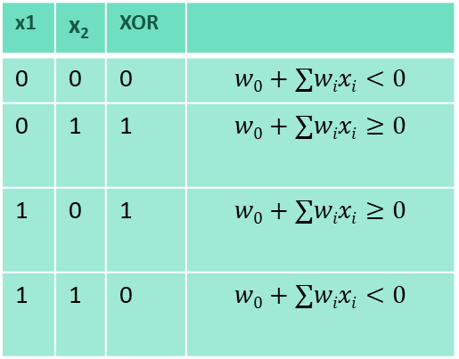
ANN
Biological Neuron
McCulloch Pitts Neuron
Boolean Functions and Decision Boundaries
Perceptron
Linearly Separable functions
x1 | x₂ | XOR
0 | 0 | 0 | $$w0+∑wixi<0$$
0 | 1 | 1 | $$w0+∑wixi≥0$$
1 | 0 | 1 | $$w0+∑wixi≥0$$
1 | 1 | 0 | $$w0+∑wixi<0$$
$$x1$$
$$(0,1)$$
$$(1,1)$$
$$(0,0)$$
$$(1,0)$$
$$x2$$
$$w0+\left(w1 ∗0\right)+\left(w2 ∗0\right)<0 =⇒ w0<0$$
$$w0+\left(w1 ∗0\right)+\left(w2 ∗1\right)≥0 =⇒ w2≻−w0$$
$$w0+\left(w1 ∗1\right)+\left(w2 ∗0\right)≥0 =⇒ w1≻−w0$$
$$w0+\left(w1 ∗1\right)+\left(w2 ∗1\right)≥0 =⇒ w1+w2<−w0$$
Forth condition contradicts condition 2 and 3

Slide 23
ANN
Biological Neuron
McCulloch Pitts Neuron
Boolean Functions and Decision Boundaries
Perceptron
Linearly Separable functions
x1 | x₂ | XOR
0 | 0 | 0 | $$w0+∑wixi<0$$
0 | 1 | 1 | $$w0+∑wixi≥0$$
1 | 0 | 1 | $$w0+∑wixi≥0$$
1 | 1 | 0 | $$w0+∑wixi<0$$
$$x1$$
$$(0,1)$$
$$(1,1)$$
$$(0,0)$$
$$(1,0)$$
$$x2$$
$$w0+\left(w1 ∗0\right)+\left(w2 ∗0\right)<0 =⇒ w0<0$$
$$w0+\left(w1 ∗0\right)+\left(w2 ∗1\right)≥0 =⇒ w2≻−w0$$
$$w0+\left(w1 ∗1\right)+\left(w2 ∗0\right)≥0 =⇒ w1≻−w0$$
$$w0+\left(w1 ∗1\right)+\left(w2 ∗1\right)≥0 =⇒ w1+w2<−w0$$
Forth condition contradicts condition 2 and 3

Slide 24
ANN
Biological Neuron
McCulloch Pitts Neuron
Boolean Functions and Decision Boundaries
Perceptron
Linearly Separable functions
Most real world data is not linearly separable and will always contain some outliers
In fact, some times there may not be any outliers but still the data may not be linearly separable
We need computational units (models) which can deal with such data
While a single perceptron cannot deal with such data but a network of perceptron can indeed deal with such data.

Slide 25
ANN
Biological Neuron
McCulloch Pitts Neuron
Boolean Functions and Decision Boundaries
Perceptron
Linearly Separable functions
Next week we will see Multilayer Perceptron,
and its learning algorithm aka Gradient Descent
Thanks

Slide 26


ANN
Biological Neuron
/
Let us see how it works
Our sense organs interact with the world out side
They relay the information to the neurons
The neurons (may) get activated and produces a response -> whether to eat the pizza or not
In reality it is just not a single neuron, but a massively parallel network of neurons
Taste
Visuals
Smell
Massively parallel interconnected network of neurons: an average human brain has around 10¹¹ (100 billions) neurons!
Each neuron may perform a certain role or respond to a certain stimulus

